Slide 1
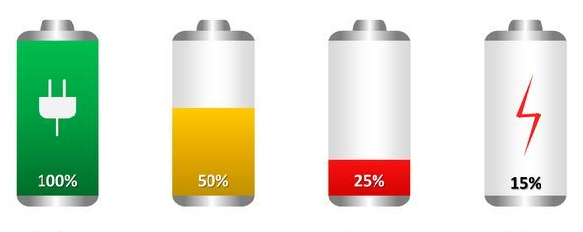

Battery Technology
Presenter: Nainsi Gupta
Guide and Mentors:
Avishkar Meshram
Nilesh Rathore
Akshay Joshi

Slide 2

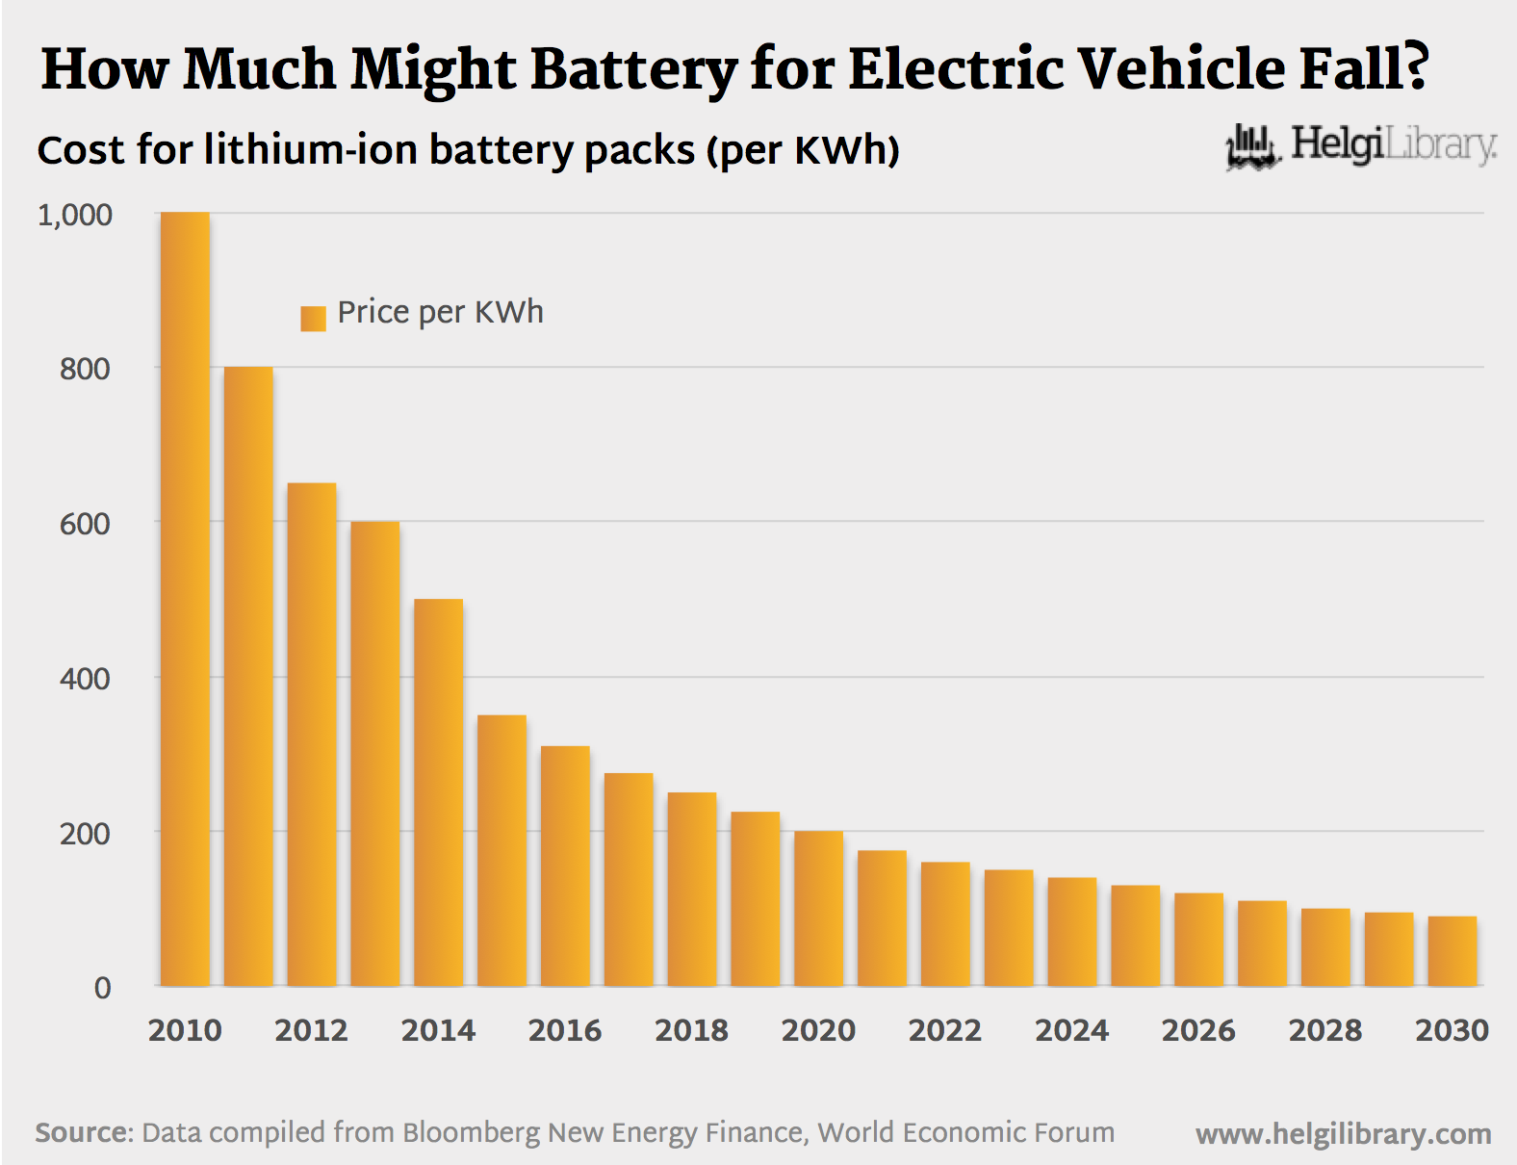
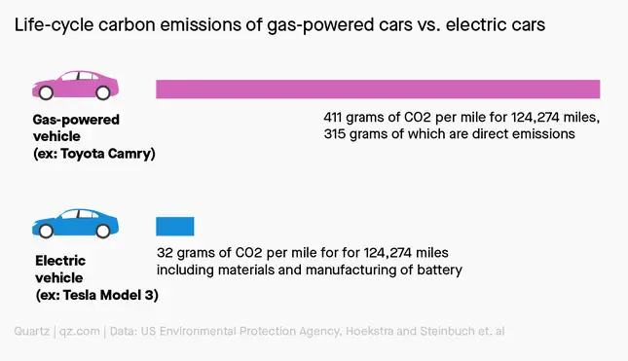
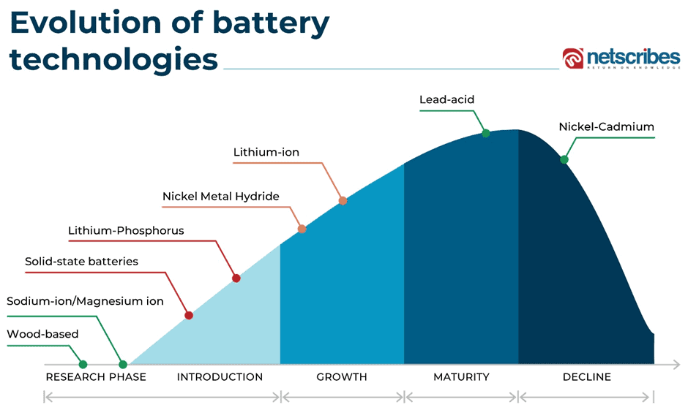
A battery is an electrochemical device that converts stored chemical energy into electrical energy.
Why is it important to learn about battery technology and its further development?
As the world is moving towards electrification to reduce dependent on fossil fuels. Development of battery technology is the key to the success of electric vehicles.
Modern life heavily relies on portable electronics devices such as smartphones, laptops and many more. Advancement in battery technology can lead to longer battery life, faster charging, more compact designs and convenience.
Better battery technology can reduce environmental footprint of both their production and disposal.
Cost of lithium-ion battery packs (per KWh)
Evolution of battery technologies
ssh
High Specific power
Longer Cycle life
Safety
High Specific energy
Expectation from a battery :
Fast charging
Low Cost
Low toxicity
Wide Operating range
Notes:
https://www.helgilibrary.com/uploads/chart_images/PriceOfEVBattery_Mar2016.png
https://i.kinja-img.com/gawker-media/image/upload/c_fit,f_auto,g_center,q_60,w_645/2d2f927712f4d419227807e7faed8689.jpg
https://sp-ao.shortpixel.ai/client/q_lossy,ret_img,w_940,h_561/https:/www.netscribes.com/wp-content/uploads/2022/10/image-2.png

Slide 3
Topics
History of Electric Vehicles
Internal combustion engine vehicle vs Electric vehicle
Types of battery
Li battery vs lead-acid battery
Charging Curve of Li battery and lead-acid battery
C-rating of a battery and its importance
Battery Chemistry
Different batteries available in market
Series and Parallel Battery Configurations of Lithium-ion
Battery Management System (BMS)
Protection given by BMS
Algorithm use for determining battery’s state of charge, state of health etc.
Battery Thermal Management System
Regulatory requirements of Government for Battery Safety
Some important Battery standard
Battery Remanufacturing & Recycling

Slide 4
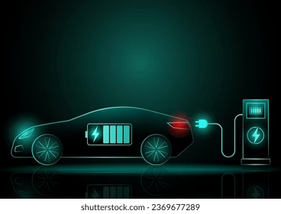

History of Electric Vehicle
Why do we need to shift towards electric vehicles?
Environmental Benefits
Energy Independence
Economic Benefits
Energy Efficiency
Modern EV
Gustave Trouvé's tricycle (1881)
world's first electric car
1912
Decline of EV popularity due to introduction of electric starter in ICE
2010
Nissan released the LEAF, one of the first mass-market all-electric vehicles
2020
Significant investment in EV infrastructure, including charging networks and battery production
2022
Continues to grow and setting ambitious targets for EV adoption and phasing out ICE by 2030-2040
1881
Demonstrated a working electric tricycle
1970
Environmental concerns revived interest in EVs
1997
Toyota released the Prius, a hybrid vehicle
2017
Tesla Model 3
were released
1828-1835
Concepts of electric motors were developed
1890-1900
Electric Cars became popular
1920-1930
EVs largely disappeared from the market
1973
The Lunar Roving Vehicle (EV) was used during the Apollo 17 mission
2006
Tesla Motors brought significant attention to EV
2012
Tesla launched the Model S, rapid expansion and adoption of electric vehicles
2019
Volkswagen announced its ID.3, part of a new series of electric vehicles aimed at mainstream consumers
2021
Grown competition in the electric SUV market
Notes:
https://en.wikipedia.org/wiki/History_of_the_electric_vehicle
https://www.shutterstock.com/image-vector/modern-futuristic-electric-car-ev-neon-2369676583

Slide 5
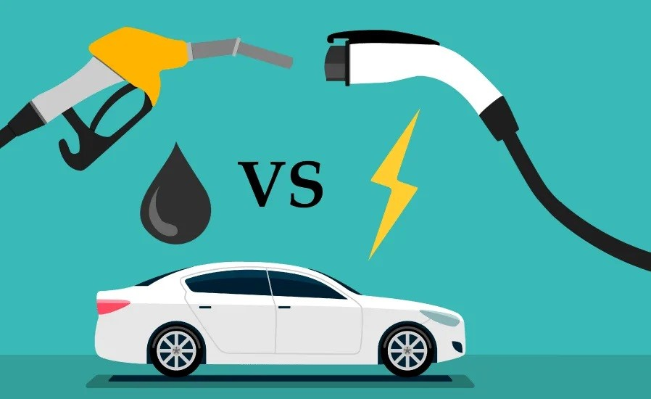
ICE Vehicles vs. Electric Vehicles
Internal Combustion Engine Vehicles
Electric Vehicles
Emit greenhouse gases
Less energy-efficient, with much energy lost as heat
High fuel costs
Known for their power and long range capabilities
Regular maintenance required (more moving parts)
It offer quick acceleration and high top speeds
Extensive and well-established network of fueling stations
Quick refueling stations
Generally lower initial purchase price
Noisier due to combustion and exhaust systems
Braking energy is not recovered
Zero tailpipe emissions
Highly energy-efficient
Lower energy costs for charging
One of the primary concern is their limited range
Less maintenance requirements (fewer moving parts)
It provide instant torque and smooth acceleration
Growing but still limited charging infrastructure
Longer recharging times
Higher initial purchase price due to battery costs
Quieter operation due to electric motors
Can recover braking energy

Slide 6
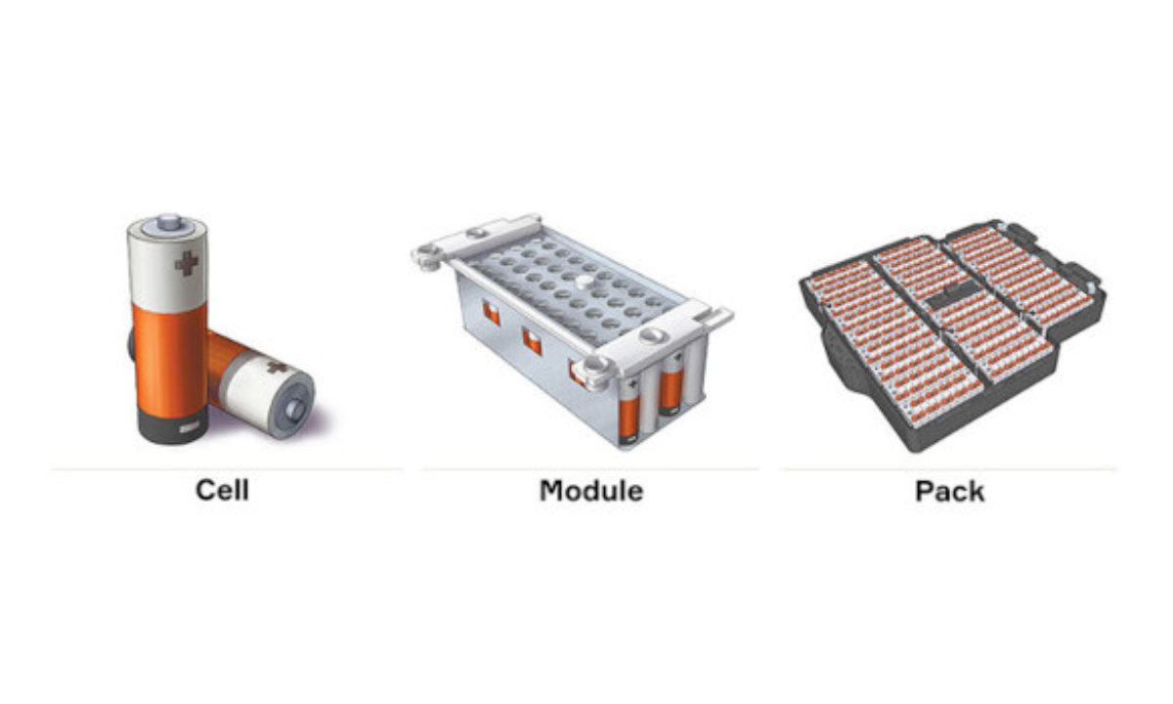
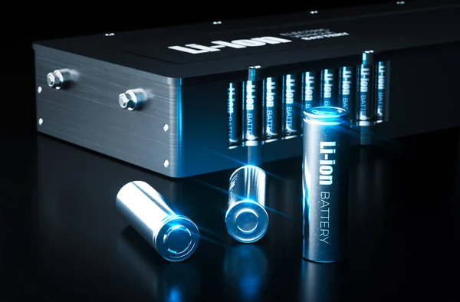
Battery
Battery cell- A Battery cell, or cell is the basic building block of a battery, which convert chemical energy into electrical energy. It usually consists of a positive electrode (cathode), a negative electrode (anode), a separator, and an electrolyte.
Battery- A battery is a device that consists of one or more battery cells, connected together to provide a specific voltage and current.
Battery Pack- A battery pack is an assembly of multiple batteries along with battery management system to meet specific requirement.
Types of battery
Primary battery
(Non-rechargeable
Alkaline cell
Daniel cell
Galvanic cell
and many more
Secondary battery
(Rechargable)
Lead-acid battery
Sodium battery (NaS,..)
Lithium battery (Li-ion,…)
Nickel battery (NiCd, NiMH,..)
and many more

Slide 7
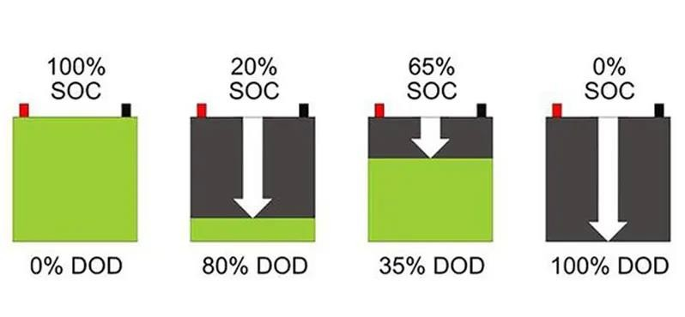
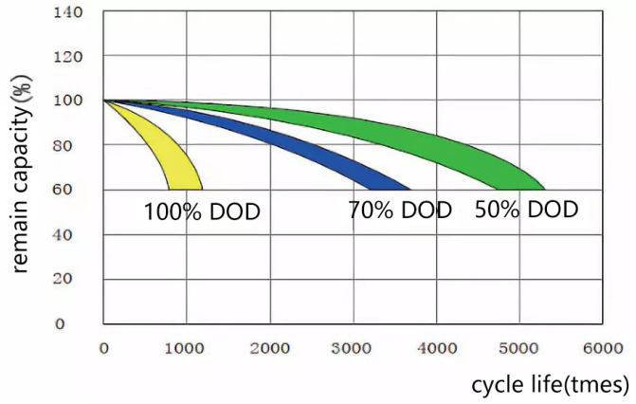
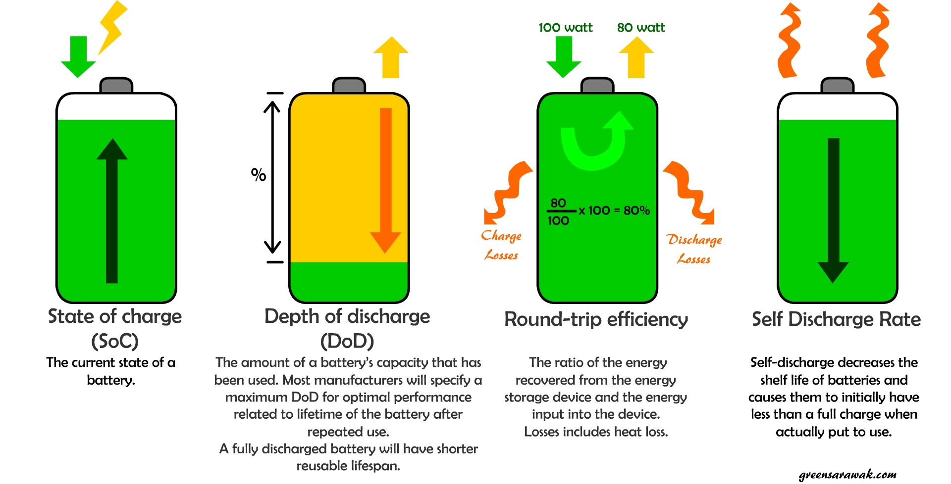

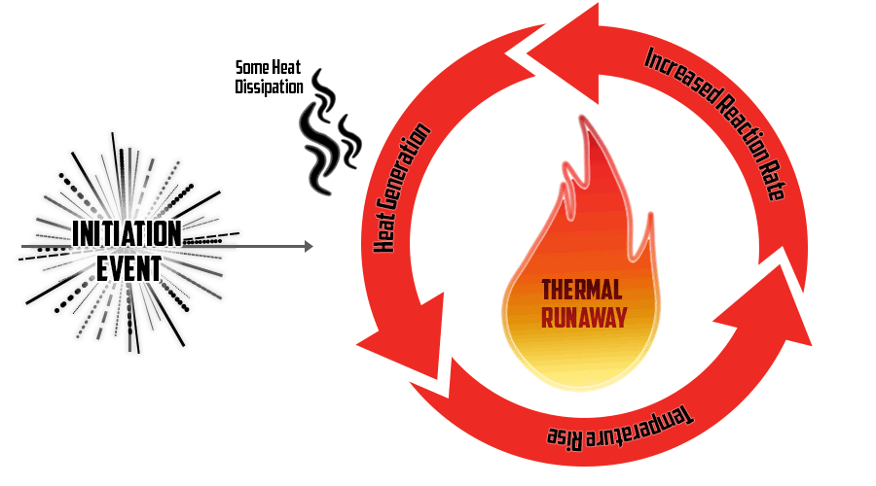
Battery Terminologies
Capacity (Ah)
Specific Energy (Wh/Kg)
Specific Power (W/Kg)
Energy Density (Wh/L)
Power Density (W/L)
Internal Resistance (ohm)
Voltage (V)
C-rate
State of Charge (SOC)
State of Health (SOH)
Depth of Discharge (DOD)
Round-trip Efficiency
Thermal Runaway: It is a chain reaction within a battery cell that can be very difficult to stop once it has started.
Notes:
https://www.builder.id/wp-content/uploads/2021/01/DOD-dan-SOC-baterai.jpg
https://media.licdn.com/dms/image/D5612AQFvb_w3_gTC3Q/article-cover_image-shrink_600_2000/0/1691726606297?e=2147483647&v=beta&t=NFONdYyHGaif_2d1DPUTkEPzBECow1p5c244rEtYcUw

Slide 8
Lead-acid battery and Lithium-ion battery
Lead-acid battery
Lithium battery
Advantages | Disadvantages
Cost-effective | Limited Energy Density
High Power Output | Limited Cycle life
Readily Available | Maintenance required
Recyclable | Temperature Characteristics are poor
Well Suited for SLI ( Starter, Light, ignition) for Vehicles | Large weight
Safe | Lead is toxic
Reliable | Highly Corrosive Sulphuric acid
Advantages | Disadvantages
High Energy Density | High Cost
Long Cycle life | Safety Concerns
Light Weight | Temperature Sensitivity
Low Self-Discharge | Limited Resource Availability
No Memory Effect | Sensitivity to Overcharging/Over discharging
Quick Charging | Aging Effect
Low maintenance | Transportation problem

Slide 9
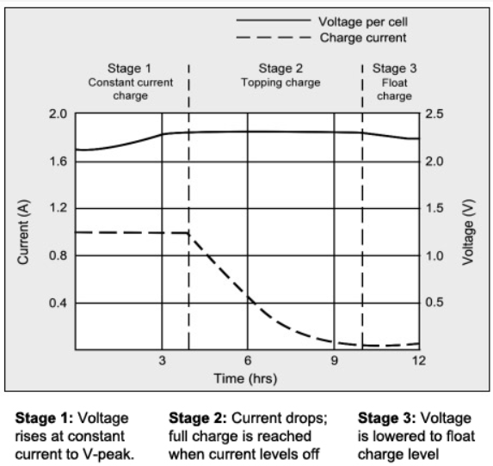
Charging Curve
Lead-acid battery
It uses constant current and constant voltage (CCCV) charging method.
During the constant-current charge, the battery charges to about 70 percent in 5–8 hours; the remaining 30 percent is filled with the slower topping charge that lasts another 7–10 hours.
The topping charge ensures that all cells in the battery are fully charged and balanced.
The float charge is a maintenance charging stage that keeps the battery at a fully charged state without overcharging.
Notes:
https://batteryuniversity.com/article/bu-403-charging-lead-acid

Slide 10
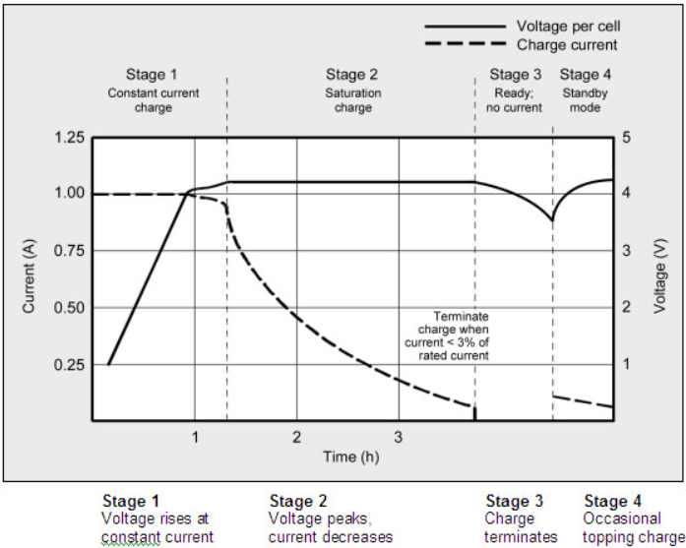
Charging Curve
Lithium battery
In CC Phase, charger applies a constant current to the battery until it reaches a predetermined voltage threshold. During this phase, the battery voltage gradually increases and charge up to 70-80% of its capacity.
In CV Phase, the charger switches to a constant voltage mode. The voltage remains steady, and the current gradually decreases as the battery approaches full capacity.
Li-ion cannot absorb overcharge. When fully charged, the charge current must be cut off.
Some chargers apply a brief topping charge to compensate for the small self-discharge the battery and its protective circuit consume.
Notes:
https://batteryuniversity.com/article/bu-409-charging-lithium-ion

Slide 11
C-Rating of a battery
The C-rating of a battery is calculated by dividing the discharge or charge current by the battery's capacity in ampere-hours (Ah).
C-rating = Current (in amps) / Capacity (in Ah)
For example, we have a battery with a capacity of 3000mAh (3Ah) and we want to discharge it
at a rate of 6A, C-rating would be = 6A / 3Ah = 2C
It means the battery can discharge at a rate of 2 times its capacity or 6A for 30 minutes, before
being fully discharged.
Similarly, if we want to charge the same battery at a rate of 1.5A, C-rating = 1.5A / 3Ah = 0.5C
It means that the battery can be charged at a rate of 0.5 times its capacity or 1.5A for 2 hours,
before being fully charged.
C-Rate | Time
5C | 12 min
2C | 30 min
1C | 1h
0.5C or C/2 | 2h
0.2C or C/5 | 5h
C-rate and service times when charging and discharging batteries of 1Ah (1000mAh)

Slide 12
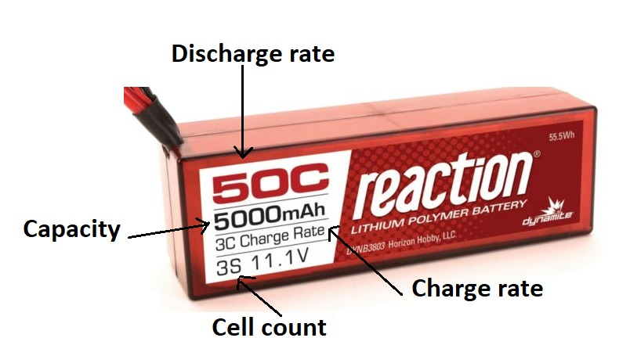
Importance of C-rating of a battery
Charge and Discharge Rate: The C-rating specifies the rate at which a battery can be charged or discharged relative to its capacity.
Performance: The C rating helps determine the maximum current that a battery can deliver or accept without causing damage or affecting its performance.
Safety: Operating a battery beyond its recommended C rating can lead to overheating, reduced lifespan, or even safety hazards such as swelling, leakage, or thermal runaway.
Compatibility: Matching the C rating of the battery with the requirements of the device or application is crucial to ensure optimal performance and longevity.
Efficiency: By selecting a battery with a suitable C rating, you can ensure that it can meet the power demands of the device efficiently without being overworked or strained, leading to better overall performance and energy utilization.

Slide 13
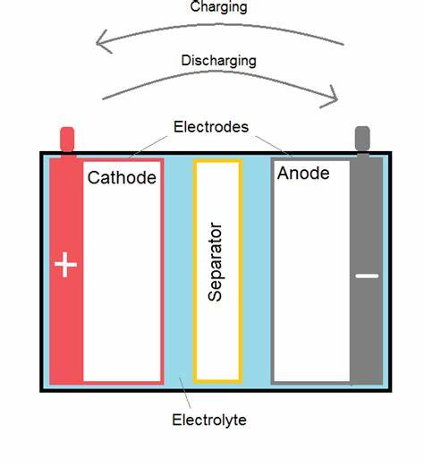
Battery Chemistry
Battery chemistry refers to the chemical reactions that occur within a battery to produce an electrical current. Batteries are electrochemical devices that convert chemical energy into electrical energy.
They are made up of one or more electrochemical cells, each of which contains two electrodes - an anode and a cathode - separated by an electrolyte.
Anode: The anode is the electrode where oxidation (loss of electrons) occurs during discharge and where reduction (gain of electrons) occurs during charging.
Cathode: The cathode is the electrode where reduction (gain of electrons) occurs during discharge and where oxidation (loss of electrons) occurs during charging.
Electrolyte: The electrolyte is the medium that allows ions to move between the anode and cathode during the charge and discharge cycles. It can be liquid, gel, or solid, depending on the type of battery.
Separator: The separator is a permeable membrane that prevents direct contact between the anode and cathode while allowing the flow of ions.
During Charging, positively charged ions move from the cathode to the anode through the electrolyte, storing energy in the battery.
During Discharging, negatively charged ions move from the anode to the cathode through the electrolyte during, delivering stored energy from the battery.

Slide 14
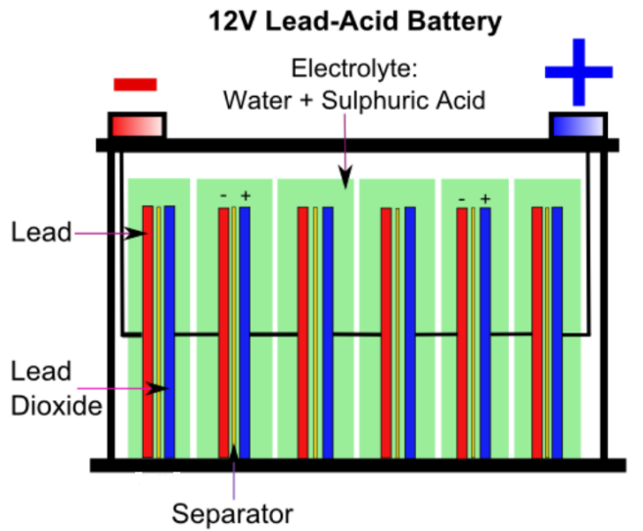
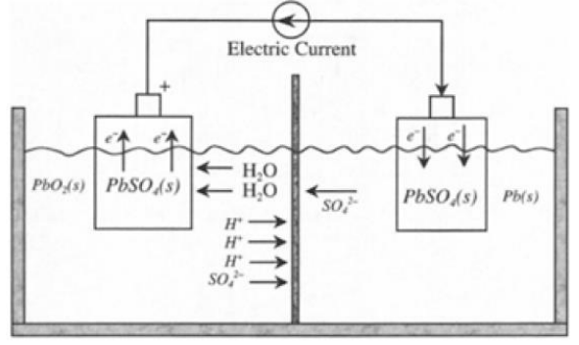
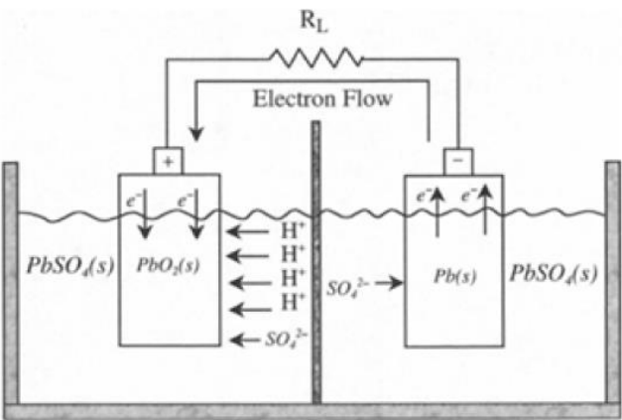
Lead-acid battery
Charging Operation
Discharging Operation
An Absorbent Glass Mat (AGM) battery is a type of lead-acid battery that uses a fiberglass mat to absorb and hold the electrolyte solution. They are sealed and do not require refilling like traditional flooded lead-acid batteries.
Notes:
Learn About Batteries - Battery University

Slide 15
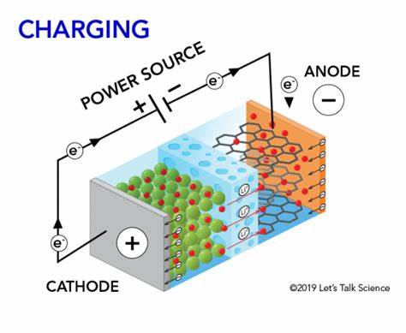
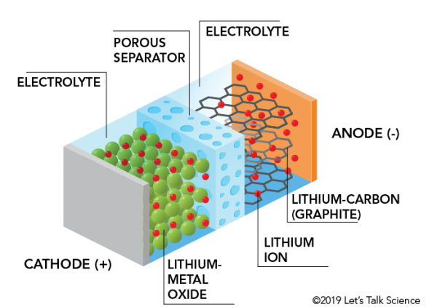
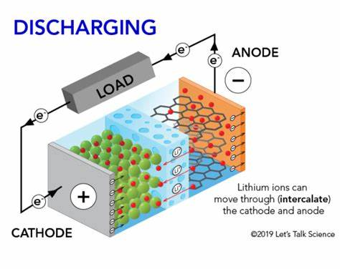




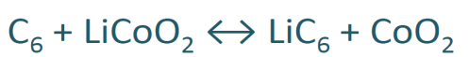
Lithium battery
Positive electrode (cathode) containing Lithium metal oxides
Negative electrode (anode) composed of graphite
Different electrolytes (water-in-salt, polymer based, ionic liquid based).
Positive electrode
Positive electrode
Negative electrode
Negative electrode
Overall reaction :
Dendrites are needle-like structures that can form on the surface of the lithium metal anode in lithium-ion batteries. Its formation is a well-known issue in lithium-ion batteries as it can penetrate the separator, causing internal short circuits, thermal runaway, and potential battery failure.

Slide 16
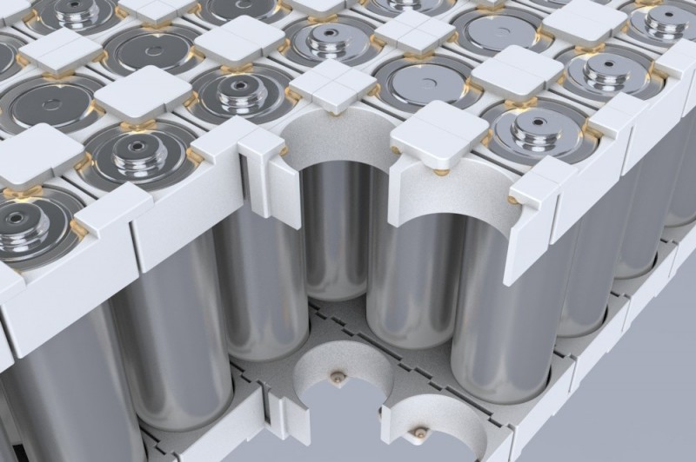
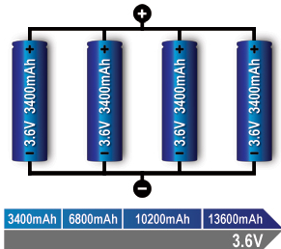
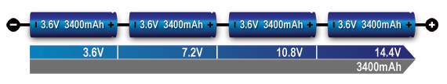
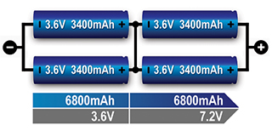
Series and Parallel Battery Configurations
Batteries achieve the desired operating voltage by connecting several cells in series while Parallel connection attains higher capacity by adding up the total ampere-hour (Ah).
Some packs may consist of a combination of series and parallel connections. If four cells are in series and two are in parallel, such configurations is called 4s2p.
It is important to use the same battery type with equal voltage and capacity (Ah) to avoid charge imbalance within cells.
Series connection of four cells – (4s)^[1]
Li-ion cell assembly
Parallel connection of four cells - (4p)^[1]
Series/parallel connection of four cells (2s2p)^[1]
Li-ion is a voltage-based system that lends itself well for parallel formation. Combining several cells into a parallel and then adding the units serially reduces complexity in terms of voltages control for pack protection.
Notes:
https://batteryuniversity.com/img/content/4s1p-x.jpg
https://content.presspage.com/uploads/2529/c800_2020-014-1-771165.jpg?74669
https://batteryuniversity.com/article/bu-302-series-and-parallel-battery-configurations

Slide 17
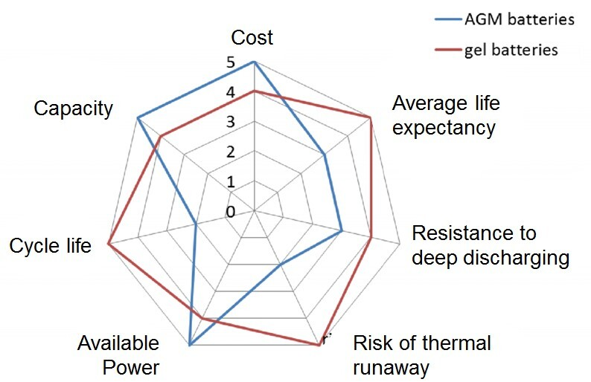
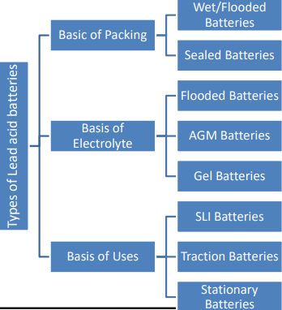
Different types of battery available in market
Lead-acid Battery
Lithium-ion Battery
Sodium-Based Battery
ZEBRA Battery
Nickel-Based Battery
Lead-acid Battery
An Absorbent Glass Mat (AGM) battery is a type of lead-acid battery that uses a fiberglass mat to absorb and hold the battery's electrolyte solution. AGM batteries are also known as valve-regulated lead-acid (VRLA) batteries because they are sealed and do not require regular maintenance or water refilling like traditional flooded lead-acid batteries.
Lead-acid batteries are used as Starting, Lighting, and Ignition (SLI) batteries due to their high cranking power, low cost, and reliability in providing quick bursts of energy for vehicle starting.
Gel and AGM batteries are part of the valve-regulated lead acid (VRLA) family to make the traditional flooded lead acid maintenance free.
A gel lead-acid battery uses silica to immobilize the electrolyte, providing a maintenance-free and spill-proof design with enhanced deep-cycle performance.
Stationary lead-acid batteries are often used for emergency power or uninterruptable power supply applications.
Notes:
https://www.bravabatteries.com/wp-content/uploads/2023/04/AGM-VS-GEL-BATTERIES.jpg

Slide 18
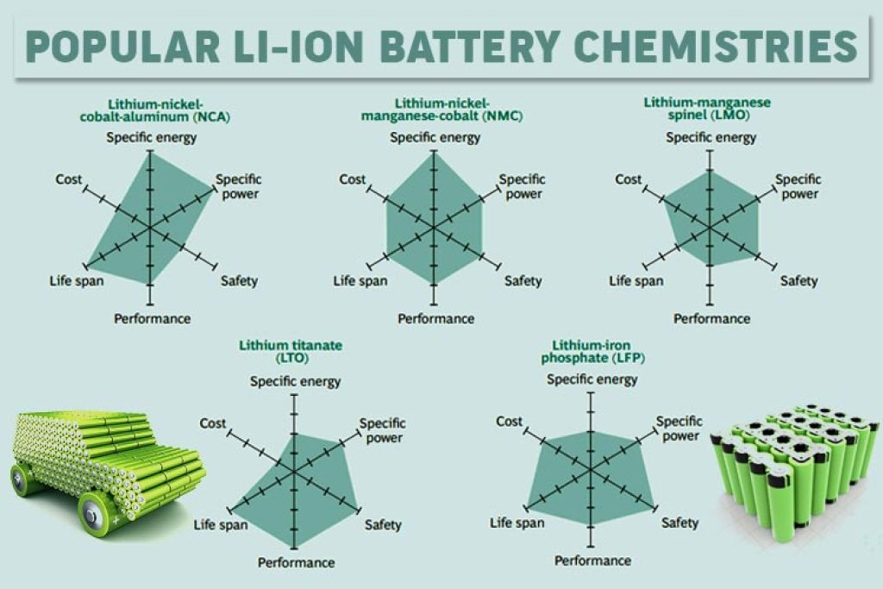
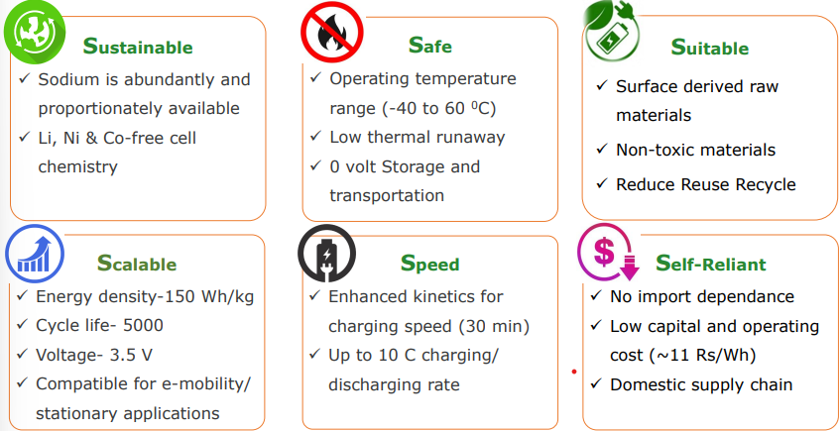
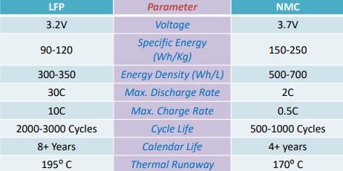
Different types of battery available in market
Lithium-ion Battery
Sodium-ion Battery
This battery received academic and commercial interest due to lithium's high cost, uneven geographic distribution, and environmentally-damaging extraction process.
Limitations
These batteries are heavier than lithium-ion batteries.
These batteries have a lower voltage, lower energy density compared to lithium-based batteries.
The technology to make sodium-ion batteries is still in the early stages of development.
Notes:
https://climatebiz.com/wp-content/uploads/2023/02/Lithium-ion-battery-chemistries-1024x683.jpg

Slide 19
Different types of battery available in market
ZEBRA Battery
Zero Emissions Battery Research Activity battery was invented in 1985 for EV application. It is also known as the sodium-nickel chloride battery, is a type of high-temperature molten salt battery that uses sodium and nickel chloride as the active materials. This battery is known for their long cycle life, high durability and thousands of charge-discharge cycles.
Nickel-Based Battery
Nickel-cadmium
Only battery that can be ultra-fast charged with little stress.
Rugged, high cycle count with proper maintenance.
Good low-temperature performance
Relatively low specific energy compared with newer systems
Memory effect; needs periodic full discharges
Nickel-metal-hydride
30–40 percent higher capacity than a standard NiCd.
Wide temperature range
Less prone to memory effect than NiCd
Requires complex charge algorithm
Sensitive to overcharge
Nickel-iron
It produces a nominal cell voltage of 1.20V.
It is resilient to overcharge and over-discharge and can last for more than 20 years in standby applications.
NiFe has a low specific energy of about 50Wh/kg, has poor low-temperature performance
Nickel-zinc
It provides 1.65V/cell rather than 1.20V, which NiCd and NiMH deliver. The specific energy is 100Wh/kg and can be cycled 200–300 times. It has no heavy toxic materials and can easily be recycled.
Nickel-hydrogen
Problems with metal instabilities in NiMH caused a shift towards the development of the nickel-hydrogen battery.
It has a nominal cell voltage of 1.25V and the specific energy is 40–75Wh/kg. long service life, even with full discharge cycles, good calendar life due to low corrosion, minimal self-discharge.
Notes:
https://batteryuniversity.com/article/bu-203-nickel-based-batteries

Slide 20
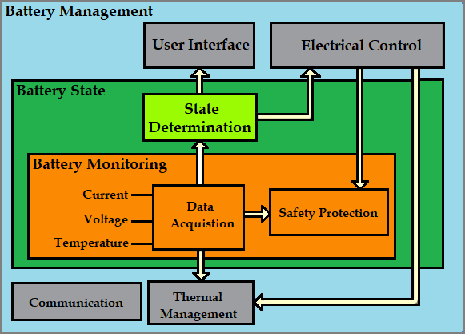
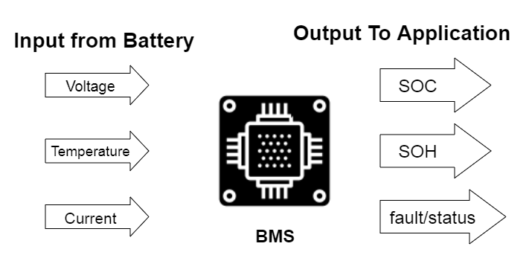
Battery Management System (BMS)
A Battery Management System is an essential component in modern battery-powered systems, providing monitoring, control, and protection functions to ensure the safety and efficient operation of battery packs.
Major Components of BMS
Battery Monitoring Unit : It is responsible for monitoring the individual cells within the battery pack.
Battery Control Unit : It is responsible for controlling the charging and discharging of the battery pack based on the data received from the BMU.
Cell Balancing Circuit : It is responsible for equalizing the charge among individual cells in the battery pack.
Battery Protection Circuit : It provides protection against overcharging, over-discharging, short circuits, and other fault condition.
Voltage and Current Sensors : They are used to measure the voltage and current levels within the battery pack.
Communication Interface : It allows the BMS to communicate with external systems, controllers, and user interfaces.
Microcontroller or Processor : It is the brain of the BMS, responsible for processing data, executing algorithms and controlling system operation.
Notes:
https://circuitdigest.com/sites/default/files/inlineimages/u/Building-Blocks-of-a-Battery-Management-System.png

Slide 21
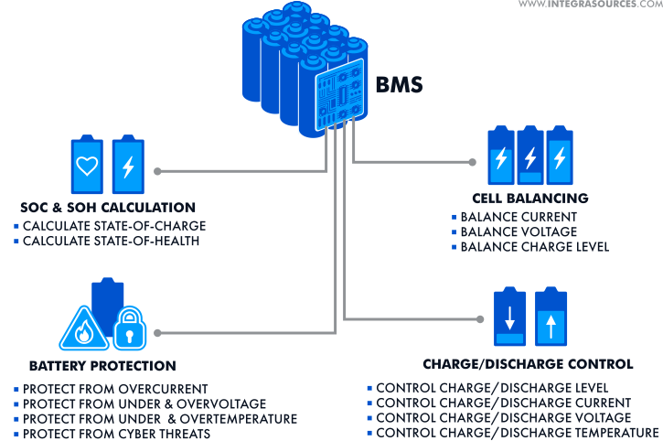
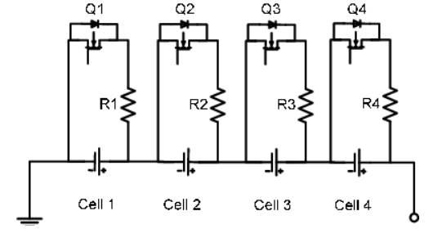
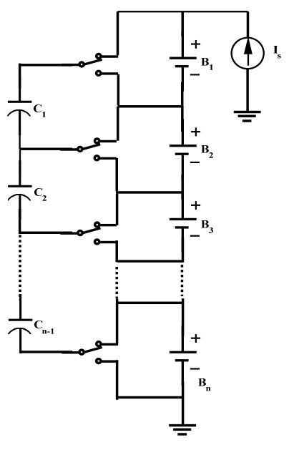
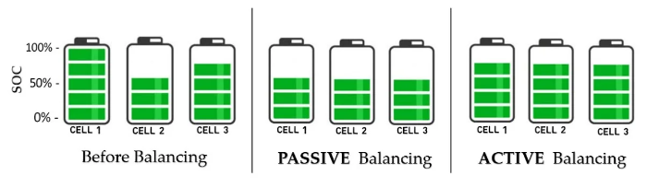
Functions of Battery Management System (BMS)
Cell Monitoring : Voltage Monitoring , Current Monitoring
State of Charge Estimation
State of Health Estimation
Cell Balancing : Passive Balancing, Active Balancing
Temperature Monitoring
Overcharge and Over-Discharge Protection
Short Circuit Protection
Communication Interfaces
Safety Shutdown Mechanisms
User Interface
Fault Detection and Diagnostics
Passive Cell Balancing Circuit
Dissipate excess energy as heat through resistors
Active Cell Balancing Circuit
Transfer energy from one cell to another
Notes:
https://i.ytimg.com/vi/ONmyxtp-p54/mqdefault.jpg

Slide 22
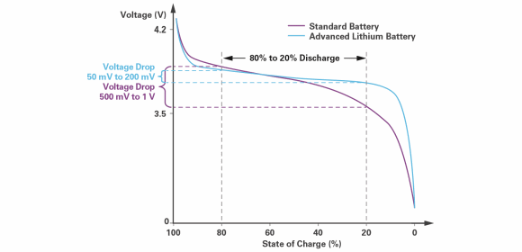
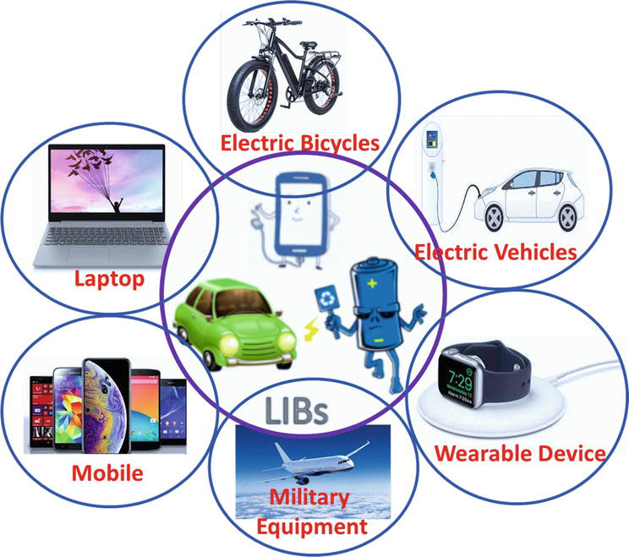
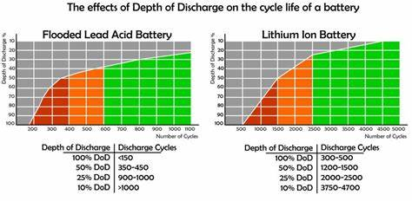
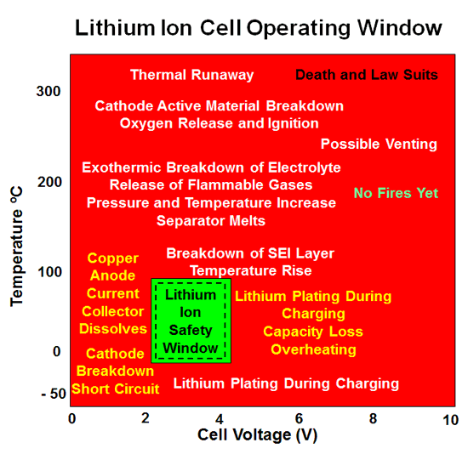
Have you ever wondered, how lithium-ion battery efficiently manage their charge and ensure safety?
Battery Management System (BMS) , an unsung hero in the realm of lithium-ion technology.
Why BMS is required for lithium-ion battery charging
Li-ion batteries are sensitive to overcharging, which can lead to thermal runaway, other safety hazards.
Over-discharging li-ion cells can cause irreversible damage and reduce cell lifespan.
Li-ion cells in a battery pack can have slight variations in capacity and voltage.
Li-ion batteries are sensitive to temperature extremes.
It is crucial for li-ion cells to operate within Safe operating Area (SOA).
Notes:
https://image1.slideserve.com/2582033/lithium-ion-batteries1-l.jpg
https://tse3.mm.bing.net/th/id/OIP.tkH7yByr2KHlFltUwHfcagAAAA?rs=1&pid=ImgDetMain

Slide 23
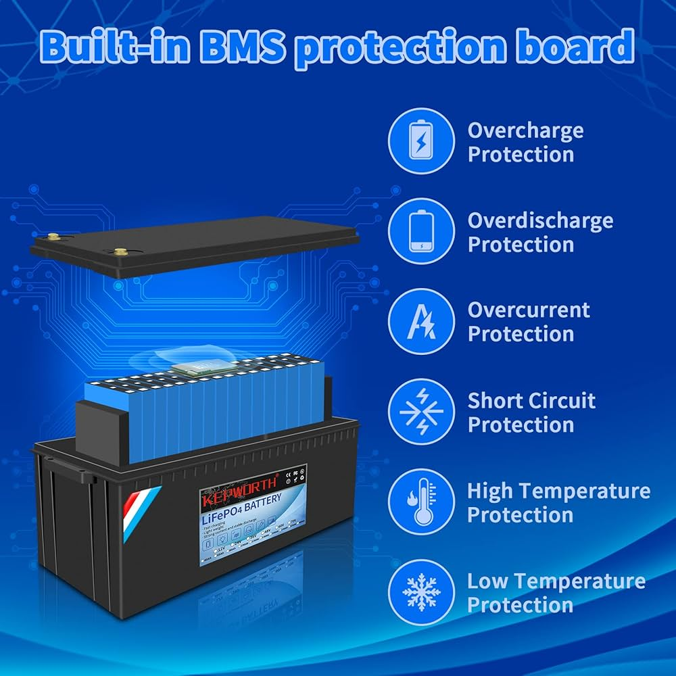
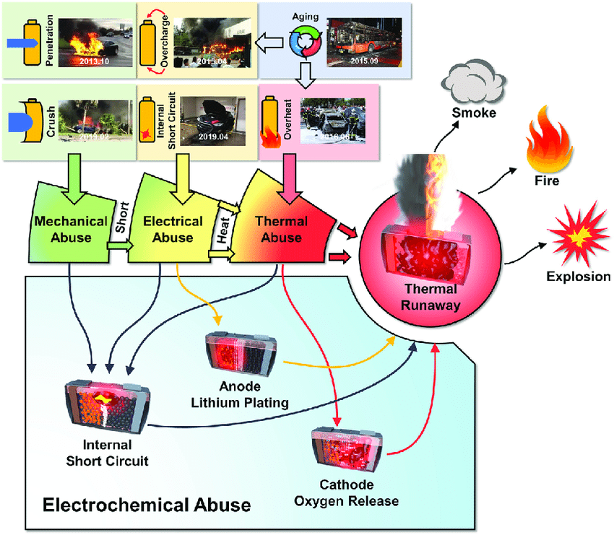

Protection given by BMS
Overcharge Protection: If any cell reaches its maximum voltage threshold, the BMS will cut off the charging current.
Over-Discharge Protection: During discharging, the BMS monitors cell voltages to prevent any cell from discharging below its minimum safe voltage level.
Temperature Protection: If the temperature exceeds safe limits, the BMS can trigger cooling mechanisms, reduce charging current, or shut down the system.
Short Circuit Protection: In case of a short circuit, the BMS will isolate the affected cells or shut down the system.
Cell Balancing: Balancing prevents any cell from becoming overcharged or over-discharged.
Current Limiting and Control: BMS limits current levels to prevent excessive stress on the cells.
Voltage and Current Monitoring: Monitoring allows the BMS to detect faults, deviations, or imbalances in real-time and take corrective actions.
Emergency Shutdown: In critical situations, BMS can initiate an emergency shutdown to disconnect the battery pack and prevent potential risks.
Hazardous Incidents due to BMS failure
Notes:
https://www.researchgate.net/publication/348637271/figure/fig2/AS:1022595034001411@1620817063824/Abuse-Conditions-that-Lead-to-Battery-Failure-The-failure-of-lithium-ion-batteries-can-be.png

Slide 24
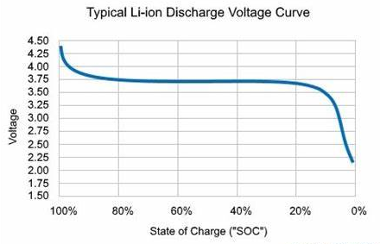
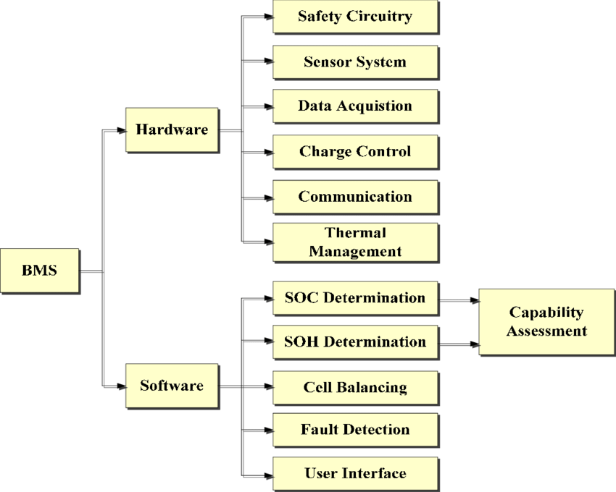
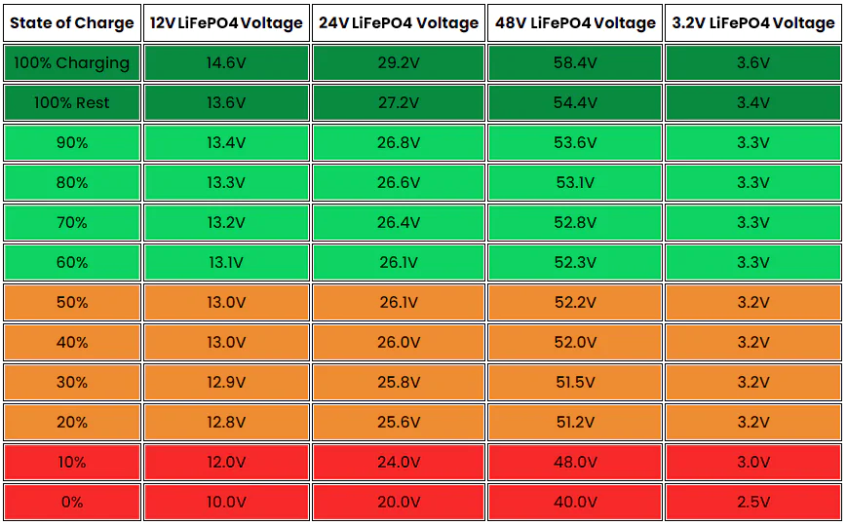
Algorithm use to determine state of charge (SOC) and state of health (SOH) of a battery
SOC Calculation
Voltage-based method
Coulomb Counting method
Kalman filtering method
Voltage-based method
Measure the battery’s open circuit voltage (OCV) and match the measured value from OCV-SOC curve or lookup table to determine the corresponding SOC value.
Limitation :
It can be inaccurate because cell materials and temperature affect the voltage.
The most blatant error of the voltage-based SOC occurs when disturbing a battery with a charge or discharge.
Accuracy depends on the battery's state, temperature, and age, which can impact the voltage vs. SOC relationship.
To get accurate readings, the li-ion battery needs to rest in the open circuit state for at least four hours, which makes this method impractical in active duty.
Notes:
https://cdn.shopify.com/s/files/1/2637/1868/files/LiFePO4_Battery_Voltage_Chart_2.jpg?v=1689209217
https://tse2.mm.bing.net/th/id/OIP.E_cfQ8plFOF_c82-O78bZQAAAA?rs=1&pid=ImgDetMain

Slide 25
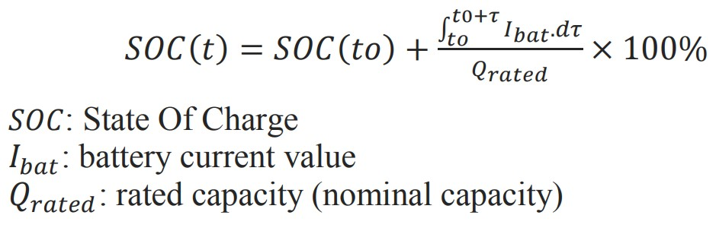
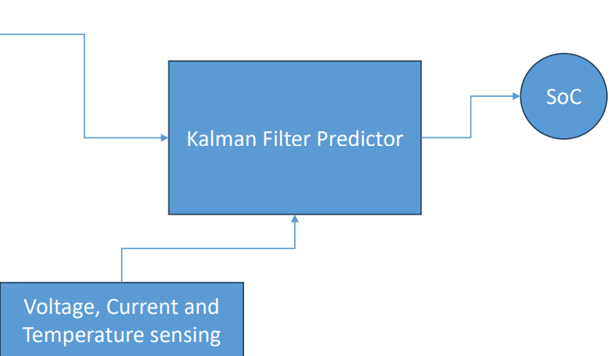
Algorithm use to determine state of charge (SOC) and state of health (SOH) of a battery
Coulomb Counting method
This method is based on the principle of conservation of charge, where the SOC is calculated by tracking the flow of electrical charge (in Coulombs) into and out of the battery. Continuously update the SOC value as the battery is charged or discharged by integrating the current and time to track the net charge flowing in and out of the battery.
Limitation:
Accumulated errors over time due to current measurement inaccuracies.
Requires calibration and periodic recalibration.
Accuracy can be affected by factors such as temperature variations, self-discharge, and aging effects.
Kalman filtering method
It is a powerful algorithm that uses a series of measurements over time to estimate the state of a system with uncertain dynamics and noisy measurements. In the context of lithium-ion battery SOC estimation, the Kalman filter combines measurements of current, voltage, and temperature to predict and update the battery’s SOC in real-time.
Limitation:
Implementing this method requires a detailed understanding of the system dynamics and model parameters.
This method may require significant computational resources for real-time SOC estimation.
Notes:
https://sklc-tinymce-2021.s3.amazonaws.com/2020/10/EQ_1602481430.jpg

Slide 26
Algorithm use to determine state of charge (SOC) and state of health (SOH) of a battery
SOH Calculation
Energy capacity-based method
Cycle count based method
Cycle count + average temperature-based method
Internal resistance-based method
Use of AI/ML
SOH is estimated by comparing the actual energy capacity of the battery with its initial energy capacity when the battery is new. The energy capacity decreases as the battery gets older.
Capacity of a battery degrades with each charge-discharge cycle it goes through. By monitoring the number of cycles, one can estimate the degradation level and overall health of the battery.
Degradation effects of cycling with the impact of temperature, providing a more thorough assessment of battery health.
The internal resistance of a battery increases as the battery degrades due to several factors . By monitoring changes in internal resistance, it is possible to estimate the SOH of the battery.
AI/ML algorithms require access to sensor data such as voltage, current, temperature, and internal resistance measurements from the BMS and can provide accurate SOH estimates based on multiple factors.

Slide 27
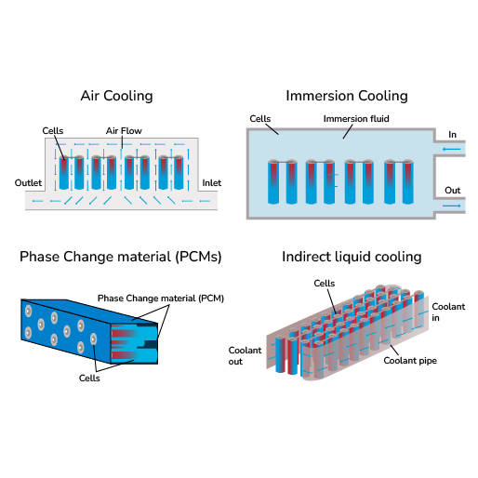


Battery Thermal Management System (BTMS)
BTMS is responsible for providing effective cooling or heating to battery cells, as well as other elements in the pack, to maintain the operating temperature within the desired range.
How BMS and BTMS are interconnected?
BMS and BTMS communicate data between each other to ensure coordinated control based on the battery's state and thermal conditions.
The BMS can also provide commands to the BTMS to activate cooling or heating systems to maintain the battery within the optimal temperature range.
In case of temperature anomalies, the BMS can trigger safety protocols, such as reducing charging rates or shutting down operations, while the BTMS adjusts thermal management to stabilize the temperature.

Slide 28



BTMS Classifications
Internal BTMS
Battery Thermal performance is improved by reducing the battery internal resistance.
Improved by modifying Anode or Cathode material, electrolyte and separator.
This is not a popular due to implementation at battery/cell manufacture only.
Active BTMS
This strategy is based on the fluid in motion, consume extra energy to power this fluid.
When liquid coolants are used, they can be in direct contact with the cells or circulate inside pipes and act indirectly.
Generally, this strategy has better capacity to dissipate heat from battery, but it is costly and more complex.
Passive BTMS
In this strategy, there is no fluid in motion, it needs specific structure on the surface of battery to remove heat (PCM or HP).
PCM : Phase Change Material
It is generally used with the aim of
improved temperature uniformity.
HP : Heat Pipe
It is used for their high thermal
conductivity and quick response.
TEC : Thermal Electric Cooler

Slide 29



BTMS Classifications
Air-forced system is required for most applications. It will be best if air can flow through almost all the areas of battery. Multiple inlet and outlets can be considered.
Liquid possesses good heat capacity & heat transfer coefficient, a suitable solution for the battery thermal management of electric vehicles, but it can add weight and additional power is required to circulate the fluid at desired rate.
PCM are substances that releases or absorbs enough energy to generate useful heat or cooling at a phase transition. They can be used to control the temperature in a wide range of applications, but in case of continuous charging and discharging cycle at high rates, there is a risk of PCM melting completely, leading to thermal instability and leakage of PCM.
Heat pipes are heat transfer devices with extremely high thermal conductivity, ensuring better heat dissipation and temperature uniformity. In general, a heat pipe is composed of three sections: an evaporator, an adiabatic section through which vapor circulates and a condenser. In most applications heat pipe is coupled with forced air or liquid cooling for a more effective heat dissipation.

Slide 30




BTMS Classifications
Hybrid BTMS
The objective of this strategy is to achieve a good temperature distribution in the battery-pack through PCM or HP and the use of forced air or liquid cooling to evacuate the heat generated to the outside.
In Immersion cooling, fluid should be electrically non-conductive dielectric fluid, such as mineral oil or synthetic oils.
Notes:
https://www.mdpi.com/energies/energies-14-04879/article_deploy/html/images/energies-14-04879-g005.png

Slide 31

Battery Safety Standards in India
Traceability of packs, additional safety fuse, protection against regenerative braking, cell-to-cell spacing and microprocessor-based BMS with all protections are in Phase 1.
Earth leakage detection charger, EMC testing of BMS, IS 16893 testing from NABL accredited lab for cells, thermal propagation test, audio-visual warning in case of a thermal event, four temperature sensors in BMS and active parallel circuits are moved to Phase-2.
The Ministry of Road Transport and Highways has decided to implement the latest amendments to AIS-156 and AIS-038 (REV 2) in two phases:
Phase 1 from 1st Dec 2022 and Phase 2 from 31st March 2023
These amendments include additional safety requirements related to battery cells, BMS, on-board charger, design of battery pack etc.
AIS : Automotive Industry Standards
AIS in India under Central Motor Vehicles Rules (CMVR)
The Bureau of Indian Standards (BIS) introduced two new guidelines (IS 18590: 2024 and IS 18606: 2024) aimed at enhancing the safety of electric vehicles in the L, M, and N categories.
These standards focus on the critical component of electric vehicles, they also emphasize the safety and performance of batteries
M category : Motor vehicles with at least four wheels used for carrying passengers.
N category : Motor vehicle with at least four wheels used for carrying goods which may also carry persons in addition to the goods.
L category : Motor vehicles with less than four wheels and quadricycle.
Battery Safety Standards in India
Notes:
https://evreporter.com/wp-content/uploads/2021/12/Battery-standards-ARAI.jpg
https://evreporter.com/battery-safety-standards-in-india-by-arai/#:~:text=New%20vs%20Old%20Regulations&text=The%20previous%20regulation%20AIS%2D048,environmental%20and%20thermal%20propagation%20tests.
UL 2580 Standard Battery Testing | Southwest Research Institute (swri.org)

Slide 32

New vs Old Regulations
Compared with the previous regulation AIS-048, the new regulations AIS-038 Rev 2/AIS-156 were significantly changed in terms of the regulatory framework, technical requirements and test methods. The previous regulation AIS-048 could test at the cell, module and battery pack levels; however, no environmental test item was included. The new regulations AIS-038 Rev 2/AIS-156 are equivalent to EU standards and include environmental and thermal propagation tests. The test objects are the battery system, subsystem and the entire vehicles. Besides, the nail penetration was removed in the new regulation, which was the most concerning test item before
REESS : Rechargeable Electrical Energy Storage System
Some of the key global standards rules for battery safety :
IEC 62133 Safety Standard: It covers aspects such as electrical, mechanical, and thermal safety to ensure the safe use of batteries.
EPA Regulations: The Environmental Protection Agency (EPA) in the United States has regulations governing the management of hazardous waste, including batteries to protect human health and the environment.
IEC 60086 Battery Standard : It cover various aspects of batteries, including naming, marking, and testing requirements for primary and secondary batteries.
ISO 26262 : ISO 26262 is an international standard for functional safety in the automotive industry, including safety requirements for electrical and electronic systems, such as battery management systems.
Notes:
https://evreporter.com/battery-safety-standards-in-india-by-arai/#:~:text=New%20vs%20Old%20Regulations&text=The%20previous%20regulation%20AIS%2D048,environmental%20and%20thermal%20propagation%20tests.

Slide 33


Some important Standards for battery
UN38.3
UN38.3 is a certification standard developed by the United Nations to ensure safe transportation of batteries containing lithium metal or lithium-ion cells. This standard is mandatory for all types of lithium batteries transported by ground, air, and sea. This testing certifies that the batteries are safe and will not pose a safety risk during transportation.
There are 8 tests required for UN38.3 certification:
Altitude Simulation
Thermal Test
Vibration Test
Shock Test
External Short Circuit Test
Impact Test
Overcharge Test
Forced Discharge Test
Why this testing is necessary?
Lithium or lithium-ion metal are highly reactive and unstable components that offer very high energy density. These batteries may experience thermal runaway if a cell in the battery pack undergoes temperatures that are higher than the battery's melting point. The battery begins to build and/or vent hot gases that could create a chain reaction with the other battery cells in the pack. Once the batteries reach this stage, they may leak, rupture, explode, or catch fire.
Due to this issue, lithium-based batteries are considered Class 9 hazardous and dangerous goods according to the United Nation regulatory organization.
All lithium chemistries must receive UN38.3 certification.
Notes:
https://evreporter.com/battery-safety-standards-in-india-by-arai/
https://amptron.au/wp-content/uploads/2022/03/un-38-3-200x200.png
https://magnis.com.au/wp-content/uploads/2023/05/UN38.3-Battery-Testing-.jpg

Slide 34
Some important Standards for battery
Environmental Tests
Thermal Cycling
Salt Spray
Immersion
UL2580
Electrical Tests
Overcharge
Short Circuit
Over Discharge Protection
Temperature
Imbalanced Charging
Dielectric Voltage Withstand
Isolation Resistance
Continuity
Failure of Cooling
The UL 2580 standard was developed by Underwriters Laboratories (UL) to evaluate the safety of lithium-ion batteries for use in electric vehicles (EVs).
The UL 2580 Testing Standard for Batteries in EVs ensures these assemblies meet stringent safety criteria, minimizing risks associated with electrical, thermal, environmental and mechanical hazards.
Mechanical Tests
Rotation
Vibration Endurance
Shock
Drop
Crush
Safety Tests
External Fire Exposure
Single Cell Failure Design Tolerance
IEC 62133
IEC 62133 is an international standard that sets out requirements and tests for the safety and performance of lithium-ion batteries used in portable electronic devices, including cell phones, laptops, tablets, and other devices.
Ensuring product safety by complying with requirements and tests set out in the standard, manufacturers can help to ensure that their batteries are safe for consumers to use.
Notes:
https://www.swri.org/industry/battery-testing-research/ul-2580-standard-battery-testing
https://www.intertek.com/batteries/iec-62133/

Slide 35



Battery Remanufacturing and Recycling
Lithium-ion batteries that power electric vehicles (EVs) are discarded when their charging capacity drops to 70%–80% of its original level.
Why it is important to reduce, reuse and recycle of the battery?
Proper disposal of batteries prevents environmental pollution by reducing the release of hazardous chemicals and heavy metals into the environment.
Recycling batteries helps recover valuable materials such as lithium, cobalt, and nickel, reducing the need for new raw materials and conserving natural resources.
Recycling coupled with reusing and remanufacturing can bring down the up-front cost of lithium-ion batteries.
Recycling batteries reduces the amount of electronic waste sent to landfills, promoting waste reduction and sustainable waste management practices.
Recycling batteries prevents potential hazards associated with improper disposal, such as fires, leaks, and contamination of soil and water sources.
Notes:
https://www.pv-magazine.com/wp-content/uploads/2019/11/Battery-recycling-1200x690.jpg
https://recyclemybattery.org/wp-content/uploads/2022/06/lifecycleimagebatteries.png

Slide 36



Methods used to Recycle Lithium-ion batteries
Due to the complex structure and number of materials in LIBs, they must be subjected to a variety of processes prior to reuse/recycling. LIBs must be first classified and most often pretreated through discharge or inactivation, disassembly, and separation after which they can be subjected to direct recycling, pyrometallurgy, hydrometallurgy, or a combination of methods.
Lithium batteries are shredded into small pieces to facilitate the separation of different components such as electrodes, separators, and casings.
The Direct recycling method extracts the spent cathode materials by physical separation process and recovers the composition and structure of cathode materials from spent lithium-ion batteries without destroying their original structure and hence yields reusable high-value materials to the battery industries.
Pyrometallurgical Process involves shredding, roasting, smelting, and metal recovery through high-temperature treatment to separate and extract valuable metals like lithium, cobalt, and nickel for reuse in new battery manufacturing.
Hydrometallurgical Process involves leaching battery components with acids, extracting metals like lithium, cobalt, and nickel, and recovering them through precipitation or electrolysis to reuse in new battery production.
Notes:
https://evreporter.com/wp-content/uploads/2019/09/Screenshot-2019-09-27-at-1.13.15-PM-768x594.png

Slide 37
Thank you!!

